Slide 1
Santander US Migration
AWS Assessment Migration Approach
October 2025

Slide 2
Agenda
Context
Current Status
Assessment Approaches
Infrastructure uplift
Application-driven migration
Proposal Considerations
Expected Deliverables
Roadmap
Efforts

Slide 3
Executive Summary
Customers typically seek the following outcomes when embarking on large-scale cloud migrations:
Cost optimization/Tech debt reduction
Increased IT staff productivity
There are often several challenges to large-scale cloud migrations, including:
Skills and experience gap
Integration and tool complexity
Cost estimation and overruns
Operational efficiency
Business agility and performance
Organisational Transformation and readiness
Scale and complexity of the migration
AWS Professional Services
Santander US Context
Santander US is undertaking a significant cloud migration initiative encompassing 3,811 virtual machines, with a diverse technology landscape comprising 70% Linux and 22.5% Windows environments. The current estate includes over 300 unique applications, requiring careful consideration of business continuity and operational stability throughout the migration journey
The AWS Professional Services Migration portfolio assessment provides a comprehensive and structured evaluation to lay a solid foundation for a successful large-scale cloud migration project
AWS Professional Services propose a hybrid migration assessment approach combining rapid infrastructure uplift with targeted modernization opportunities. The engagement will focus on technical portfolio discovery and assessment, leveraging automated tools and expert analysis to create a migration strategy that balances speed with optimization.

Slide 4
2. Current State:
Context Data Analysis
Column “CI ID”: ID of individual virtual machines.
Out of the 7207 entries: target is 3811 virtual machines (the rest of 3395 are duplicates, which indicates a level of shared infrastructure)
70% is Linux, 22.5 % is Windows. The rest is AIX and unknown OS
over 300 unique applications (based on data points in Prod)
Open Points
Disaster Recovery and target Landing Zones
Deeper information about : CPU, RAM (min, max, avg), disk size, disk utilization, etc. collected over a certain period of time
AWS migration tooling and migration strategies (compatibility):
OS version
List of databases, database engines and their versions
Details on shared storage (if relevant)
Migration strategy per component: application component-to-server mapping
Migration wave planning: Application-to-application dependencies (eg port-to-port communication)

Slide 5
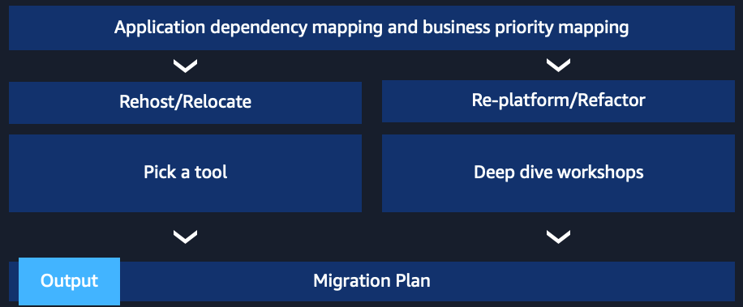
3. Assessment approaches

Slide 6
3.1 Portfolio Assessment approaches
Approach 1 (Infrastructure uplift): Focus on speed (eg due to regulatory constraints, resilience challenges, DC renewal dates) Core migration strategies: Rehost & Replatform (at least 80% of the estate – need to be confirmed)
Recommended assessment approach:
Collect infrastructure, application & networking data with an automated tool specialized on planning for infrastructure uplift (eg modelizeIT)
Enhance automatically collected data with business details specific to Santander (eg business names of application extracted from CMDB, firewall rules like F5 iRules to complement the traffic data captured by the tool)
For Database replatforming (homogenous engine migration to managed DB service in AWS), we recommend leveraging AWS SCT tool. This can run in bulk and the outcome is a detailed evaluation of the compatibility with the AWS target, including detailed mitigation measures
Optional: Landing Zone assessment to ensure, at minimum:
Available throughput aligned with the migration wave plans
Operational readiness to take over the Day2 Ops post-migration
(Recommended for initial portfolio assessment)

Slide 7
3.2 Portfolio Assessment approaches
Approach 2 (Application-driven migration): Focus on the ROI and business benefits at individual application level Core migration strategies leveraged in this approach: Rearchitect, Replatform and to a small extent Rehost
Recommended approach:
Run modernization-focused tooling to obtain an indicative view on the modernization patterns (eg CAST software)
Execute deep dive discovery workshops and pilot modernizations for key modernization patterns identified
(Recommended for detailed migration assessment of key applications target for modernization)

Slide 8
4. Proposal Considerations
The success of this migration assessment engagement is fundamentally dependent on the active participation and dedicated collaboration of key Santander team members throughout the entire process. Enterprise Architects will play a pivotal role in providing strategic guidance, technical oversight, and critical decision-making support that will shape the migration strategy and execution approach.
Technical subject matter experts, including Systems Administrators, CMDB Representatives, and Database Administrators, must be readily available to support comprehensive discovery activities, data extraction, and validation efforts. Their expertise is crucial for ensuring accurate assessment of the current environment and developing viable migration plans that address all technical considerations.
Application Owners and business stakeholders must maintain consistent engagement to provide essential business context, validate application dependencies, and approve proposed migration strategies. This collaboration framework requires timely responses to data requests, regular participation in discovery sessions and workshops, and established escalation paths for quick resolution of any blockers. Access to systems, documentation, and decision-makers will be critical success factors in maintaining project momentum and achieving the desired outcomes of this complex migration initiative.

Slide 9
5. Expected Deliverables
Comprehensive Infrastructure discovery
Application discovery (necessary within the scope of the Infrastructure uplift) based on technical data collected with the automated tool
Enhanced application discovery, complemented by business details (eg CMDB extracted infos like application business name, RTO, RPO)
Application dependency mapping
Migration strategy aligned to AWS 7R disposition logic
Initial migration wave planning derived from technical dependencies
List of recommended pilot applications (up to 5) for an initial Proof of Value, including target architecture
Directional business case
Migration Readiness Report: A detailed list of recommended actions and next steps to enable a successful migration to the cloud. The actions may include priority, level of effort, due date and assignee
(Optional) Learning Needs Analysis report

Slide 10




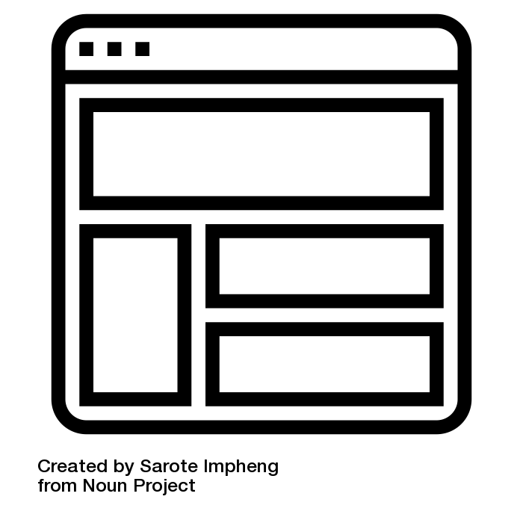


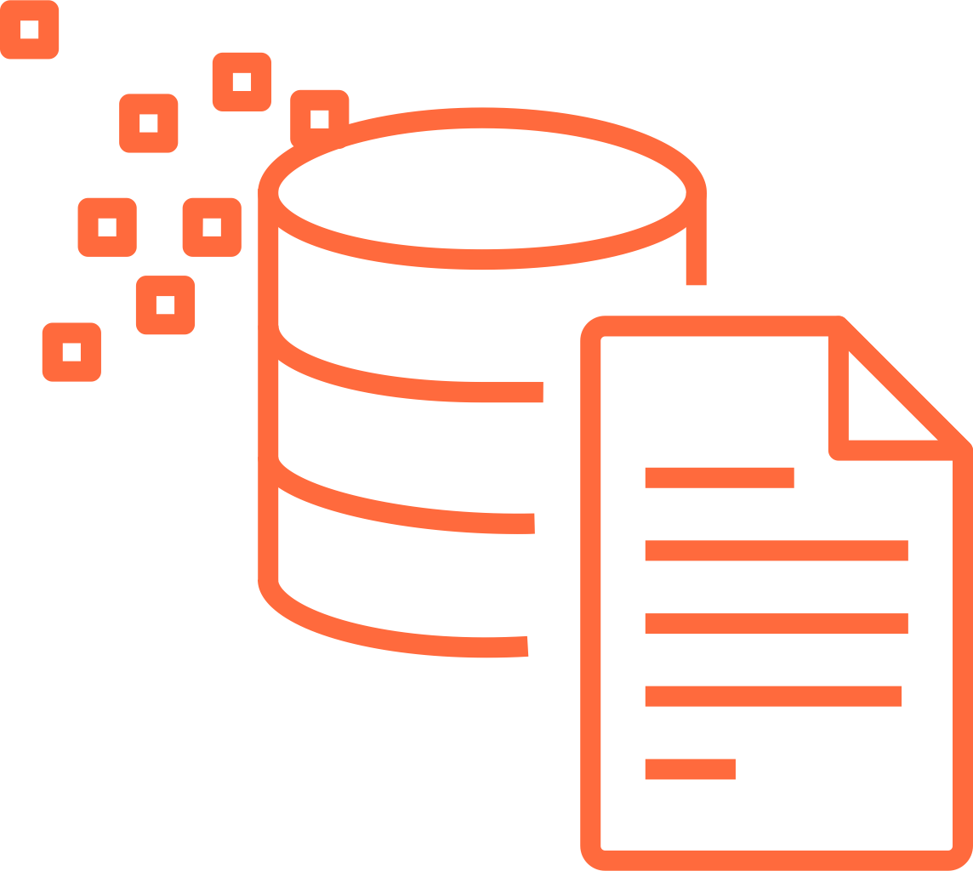
(*) Best practice is to plan up to 4 weeks for automatic data collection tools to run and ensure peak activity is captured. Data processing should start once the automatic data collection is finalized
5. Expected Timeline
Up to 4 weeks prior
to engagement start
Weeks 1-3
Weeks 2-11 (*)
Week 12
Pre-Sessions
Workshop #1
(Migration Readiness Assessment)
Process data inputs
Closing Workshop
(artifact review, next steps)
Pre-Workshop Questionnaire Completion
Deep Dive and Review sessions with Application teams and Enterprise Architecture
Identifying
Attendees
Output
Evaluate metadata of existing data sources
Evaluate alternative data enhancement tools
Migration Readiness Report
Findings report
Directional Business Case
Outcome of the Portfolio Assessment (see ”5.Expected Deliverables for comprehensive list”)
Recommendations for Pilot Applications and their target architecture
Initiate Learnings Needs Analysis Survey
Process Inventory data
Action list
Output
Data Collection
Roadmap
Install
Discovery tool(s)
(Optional) Learning Needs Analysis report
(*) Automatic Data Collection
Current Data sources
Mega, CMDB, ServiceNow data
Target Architecture and Deep Dive sessions for up to 5 Pilots

Slide 11






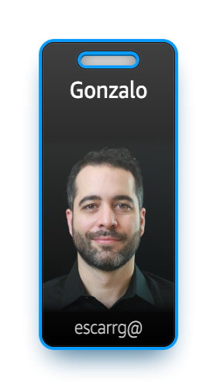
7. Effort, Team and pricing
Proposed Team Structure
Pricing
AWS ProServe team (6 weeks)
Santander
Engagement Mgr
Portfolio Analysis Migration
Data Base Specialist
Security and Compliance
Executive Sponsors
Engagement Manager
Cloud Ops/ Cloud Engineering team(s)
Santander Billable ª : $206.188
Account Team Support
In addition to above ProServe team, AWS will also leverage the Account team resources with deep Santander context to enable outcomes across the effort
Infrastructure, Network, Database leads/ SMEs
Application Architects and Developers
Pricing above does not include a 15% travel and expense budget, in case Santander requires the ProServe team to be present in Santander offices

Slide 12




Appendix: AWS Migration Framework
Assess
Mobilize
Migrate & Modernize
Portfolio
Migrate
Discovery & planning | Migration plan | Business case/ Mig. Evaluator | Migration & modernization experience
Culture, Leadership, & Change | Landing zone | Operating model | Security & compliance
Migrate
Migration Readiness Assessment
Rapid discovery
TCO report
Accelerators
Operate & optimize
Briefings & workshops
Modernize
Immersion day
People
Platform
Create a case for change
Build readiness through experiences
Accelerate transformation at scale
Using a proven framework greatly increases your odds of success and speed to market

Slide 13


































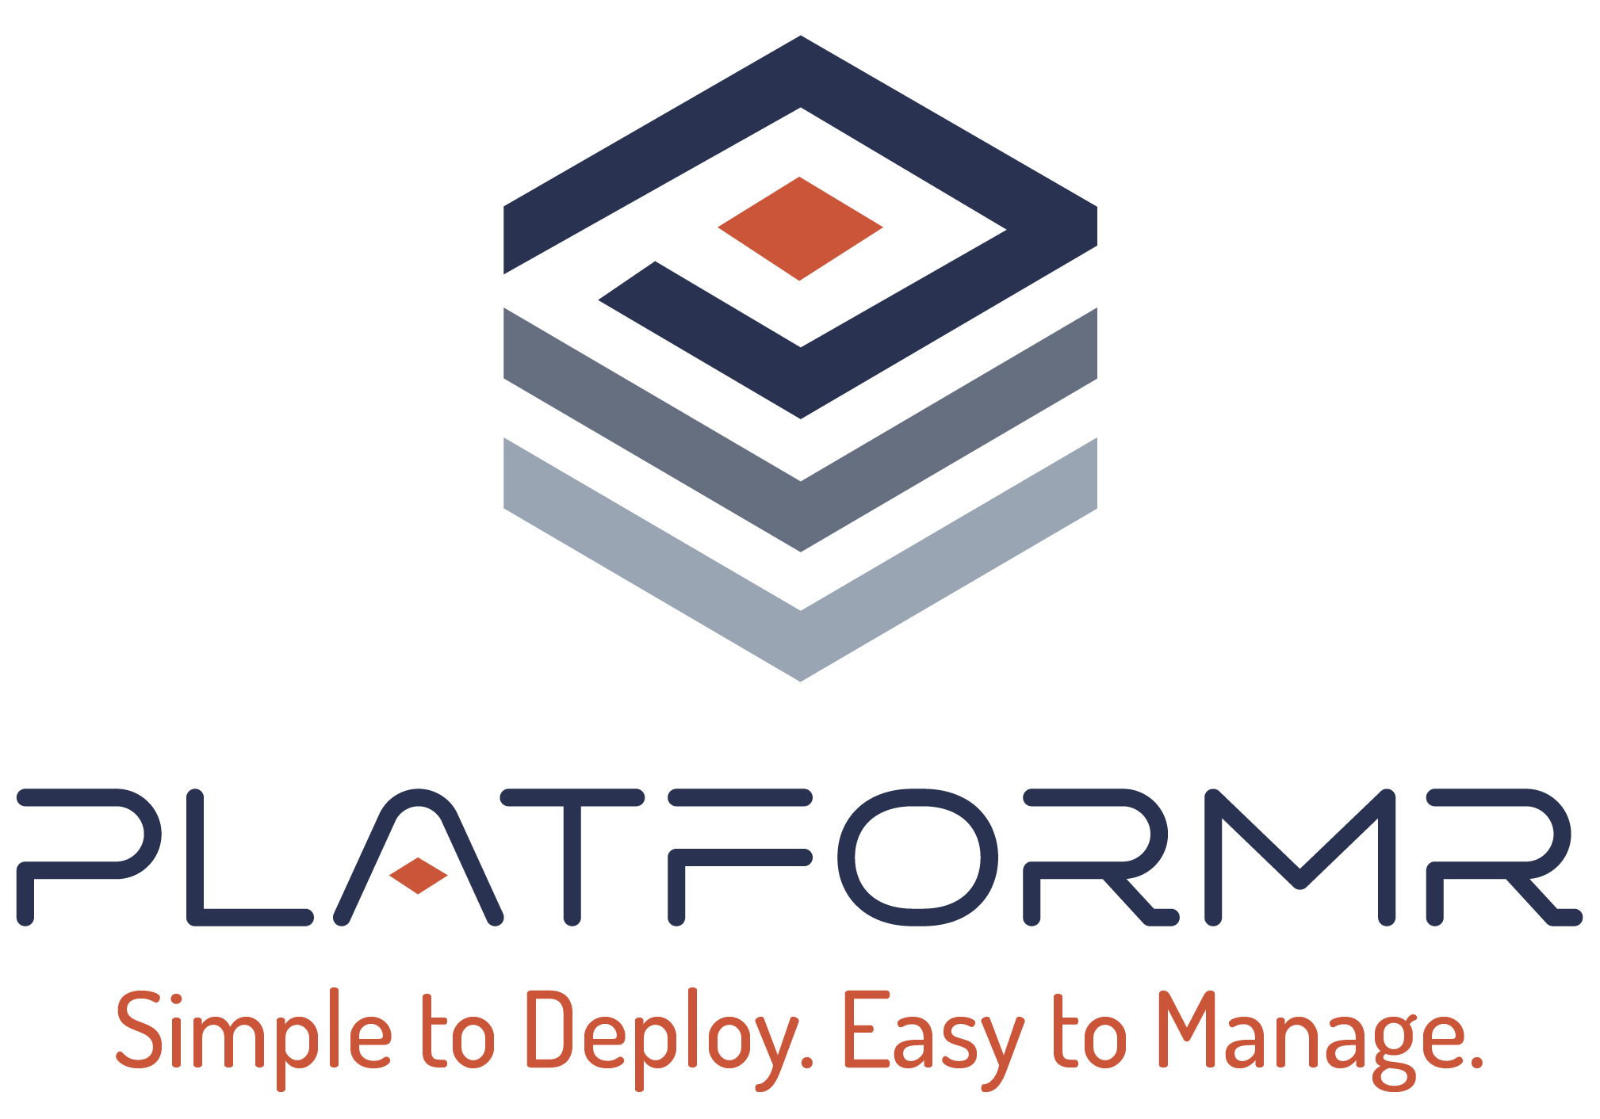

Appendix: AWS & AWS Partner Tooling
Assess
Mobilize
Migrate
Modernize
Monitor/Optimize
Inventory
Business Case
Discover & Plan
Landing Zone
Move Applications & Data
Cloud Operations
AWS Migration
Evaluator
AWS Migration
Evaluator
AWS Transform
AWS Control Tower
AWS Application Migration Service
AWS Transform
Amazon
CloudWatch
AWS
CloudTrail
AWS Transform
Migration Portfolio Assessment
ECS & EKS Blueprints
AWS Database Migration Service
(VMware, Mainframe, Java & .NET)
AWS Config
AWS Well-Architected
AWS Tools
Modernization Calculator
AWS DataSync
AWS Microservice Extractor for .NET
AWS License
Manager
AWS Compute
Optimizer
AWS Snowball
AWS App2Container
AWS Resource
Explorer
AWS Trusted Advisor
AWS Transfer Family
AWS Blue Age
Partner Tools

Slide 14
Appendix: Migration Readiness Assessment Overview
The assessment includes question survey and interactive activities conducted as a 1-day workshop:
Alignment of leadership teams
Consensus on decision-interdependency
Identification of gaps and readiness
Action plan and proposal to close the gaps and accelerate to the next phase of adoption (e.g. Accelerators, Mobilize project)
Business Capability Focused | Business Value Realization
 | People Roles and Readiness
 | Governance Prioritization and Control
Technical Capability Focused | Platform Applications and Infrastructure
 | Security Risk and Compliance
 | Operations Hybrid and Dynamic
Diagnose migration readiness, align leadership teams, and build a case for change

Slide 15
Appendix: Migration Readiness Assessment Journey
Preparation
Pre-Workshop
Pre-Workshop Questionnaire Completion
Identifying Attendees
Assessment focus
Workshop
Voice of the Customer & EBA Activities
Stakeholder conversations and cross-functional teams consensus
Alignment on business strategy, IT drivers and tactical implementation needs
Success patterns and trends
Business & Technical
Business
People
Governance
Platform
Security
Operations
Results
Captures
Observations (Weaknesses & Strength)
Roadblocks & Gaps
Readiness Rating
Roadmap of critical-path actions
Builds
Team Alignment
An Initial Project Plan
Knowledge and Skills Plan (Readiness Plan)

Slide 16
Appendix: Migration Readiness Assessment Report

Slide 17
Appendix: Overview Learning Needs Analysis
Identify skills gaps across roles & functional areas
Address the gaps with customized training plans
Identify executive sponsor and provide team structure
Distribute survey
to employees
Santander
1
5
Review and
approve survey
Send reminder email
Survey close date
3
7
8
Week 1
Week 2
Week 3
Week 4
AWS
4
6
9
Provide survey URL and
email template
Provide survey
response numbers
Create Report
&
Provide training recommendations
2
Create survey and
provide preview URL

Slide 18
Appendix: Agentic Migration and Modernization
Reduce costs with right sizing and lower TCO
Modernize VMware workloads to Amazon EC2 with purpose-built AI agents
AWS Transform for VMware
Eliminate third-party license fees and lower costs
The first agentic AI service for migrating VMware workloads at scale
Drive innovation with 200+ AWS native services

Slide 19
Appendix: Agentic migration options for VMware Rehost
How it works
1
2
3
4
5
Connect to your VMware environment
Analyze workloads, dependencies, and readiness
Convert VMware networking configurations to native AWS constructs
Generate intelligent wave plans based on application dependencies
Validate with your team, then execute
STEP-BY-STEP TRANSFORMATION WITH HUMAN-IN-THE-LOOP VALIDATION
Note: The feasibility of using the agentic capabilities will be assessed during the data discovery phase

Slide 20
Appendix: Why partner with AWS Professional Services
Unlock 184 hours of AWS investment
Maximize efficiency and impact by concentrating your assessment efforts into a focused, intensive 3-month period, rather than spreading resources thin over prolonged evaluations
Leverage AWS proven methodology built in 1000’s customers engagements with accelerators for quality, speed, and desired outcomes
Receive comprehensive assess outputs for a seamless transition to mobilizing for Migration
Migration experience, including Agentic AI accelerators

Slide 21

























Appendix: Sample Customers

Slide 22
Appendix: Sample Customer Reference
“Our goal was to create a robust environment that fosters innovation while keeping things simple, cost-effective, and productive.”
Mark Hill Chief Digital Information Officer CSL
Accelerated initial wave planning by 10x
Accelerated application discovery time by 12x for each application
On track to exit 17 data centers in 30 months while realizing 30% operational cost savings

Slide 23

“At 1CloudHub, AWS Transform for VMware significantly accelerated our VMware-to-AWS migration assessment for our customer, a 'global virtualization platform' provider. It reduced execution time by 40% and cut manual effort by 60% in key areas like dependency mapping and compliance. With AI-driven insights, we created optimized wave plans projected to lower migration costs by 30–40%, while improving security, compliance, and business alignment.”
Appendix: Sample Customer Reference

Slide 24
6. Migration Roadmap
 | Workstreams | Short description | Out of scope | W1 | W2 | W3 | W4 | W5 | W6
Infrastructure-led approach | Portfolio Discovery | Detailed infra discovery + application overview (mainly application components and application dependencies) | Detailed app by app modernization strategy Detailed app-based business case Detailed app by app target architecture in AWS Detailed target Disaster Recovery strategy
 | Portfolio assessment | Initial migration strategy per technical components and technology stack
 | Database assessment (excl Exadata, Oracle RAC, DB2) | Initial target migration strategy based on DB technology stack
 | (Optional) License assessment | Complimentary Microsoft and Oracle license assessment to inform migration strategies
 | Disaster Recovery discovery | Understand existing disaster recovery strategy
 | Finalize Target migration strategy | Final report with groups of target migration strategies

Slide 25

6. AWS proposed migration roadmap
25 weeks
Review Available Data
(1.5 week)
Deploy Discovery Tool
(1 week)
Portfolio Analysis Migration
(13 Weeks)
Modernization Tool
(10 weeks)
CMDB, RVtools extract for VMware to determining:
Data completeness for the analysis
Data accuracy Data gaps (if any) to advise on alternative tooling to be leveraged for an accelerated discovery
Based on the data gaps assessment
Recommend automatic data collection tooling OR
Recommend data consolidation approach based on existing data
Run Migration Tool: Example PMT
Business Critical Information (from CMDB)
RTO (Recovery Time Objective) | RPO (Recovery Point Objective)
Application Business Names & Investment Strategy Status
Application Lifecycle Details
Current State Assessment
Sunset Planning Status
Future State Recommendations: Rehost (if cloud compatible) or Retain (if not suitable for migration)
Business Continuity Review
Current Backup Solutions & Backup strategies: Retention policies | Recovery procedures
Disaster Recovery Assessment: Current DR architecture, Recovery capabilities, DR testing procedures
Decision Matrix Factors
Application Cloud Compatibility
Business Criticality
Technical Dependencies
Lifecycle Stage
Assess the level of technical deb:
Assess the cloud migration readiness for application components: application dependency mapping, migration strategy and business validationion
Deploy modernization tool:
for deep insights into the modernization path and effort estimation (eg CAST Imaging) - assume a sample of up to 5 applications, based on modernization patterns prioritized in the step above
Database analysis with AWS SCT:
tool based on the excepted depth of the assessment
Assessment Report

